Slide 1
Welcome to Javascript

Slide 2
Array Methods
slice():
The slice() method slices out a piece of an array into a new array
The slice() method does not remove any elements from the source array.
const fruits = ["Banana", "Orange", "Lemon", "Apple", "Mango"];
const citrus = fruits.slice(2);
//slice() method can take two arguments like slice(1, 3)
const citrus = fruits.slice(1,4);
Sorting an Array:
The sort() method sorts an array alphabetically
Reversing an Array:
The reverse() method reverses the elements in an array
const fruits = ["Banana", "Orange", "Apple", "Mango"];
fruits.sort();
const fruits = ["Banana", "Orange", "Apple", "Mango"];
fruits.reverse();

Slide 3
Array Methods
indexOf():
searches an element of an array and returns its position
//finding the index position of string
const position = dailyActivities.indexOf('work');
console.log(position); // 2
includes():
The includes() method returns true if an array contains a specified value
const fruits = ["Banana", "Orange", "Apple", "Mango"];
fruits.includes("Mango");
isArray():
Check if an object is an array
const fruits = ["Banana", "Orange", "Apple", "Mango"];
let result = Array.isArray(fruits); // true
let text = “testStringArray";
let result = Array.isArray(text); // false

Slide 4
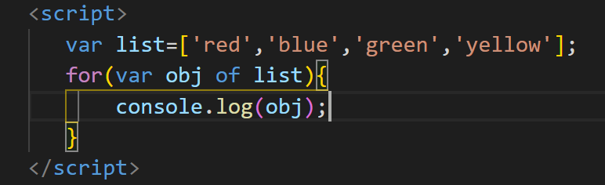
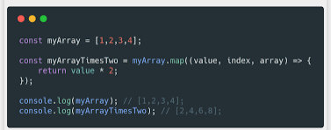
Array Loops – For & Foreach
for:
const fruits = ["Banana", "Orange", "Apple", "Mango"];
for (let i = 0; i < fruits.length; i++) {
console.log(fruits[i]);
}
foreach():
const fruits = ["Banana", "Orange", "Apple", "Mango"];
fruits.forEach(function(item){
console.log(item);
})

Slide 5
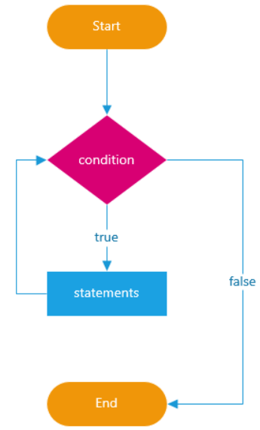
JavaScript Loops
In programming, loops are used to repeat a block of code
For example, if you want to show a message 100 times, then you can use a loop. It's just a simple example; you can achieve much more with loops.
For loop
While loop
do while

Slide 6
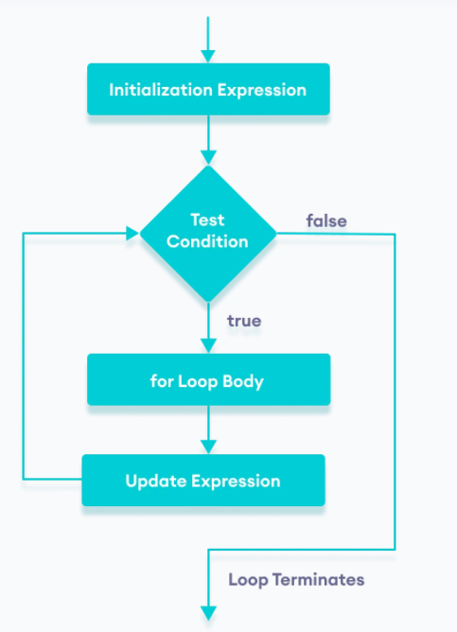
JavaScript Loops - for
The for loop requires following three parts.
Initializer: Initialize a counter variable to start with
Condition: specify a condition that must evaluate to true for next iteration
Iteration: increase or decrease counter
Syntax
for(initializer; condition; iteration)
{
// Code to be executed
}
Example
for (var i = 0; i < 5; i++)
{
console.log(i);
}
let n = 5;
// looping from i = 1 to 5
for (let i = 1; i <= n; i++) {
console.log(`I am learning JavaScript.`);
}

Slide 7
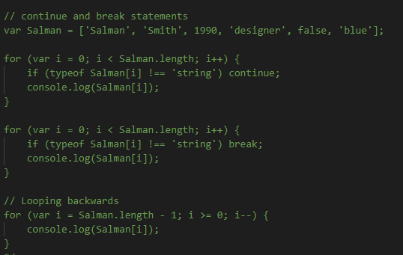
Continue and break statement

Slide 8
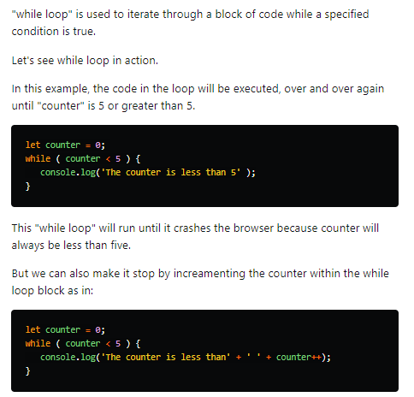
While Loop

Slide 9
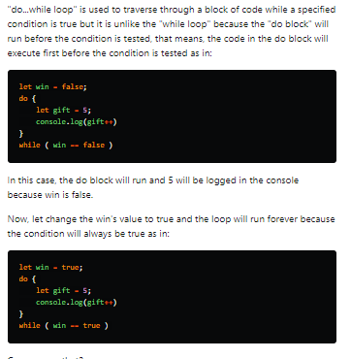
Do While Loop

Slide 10
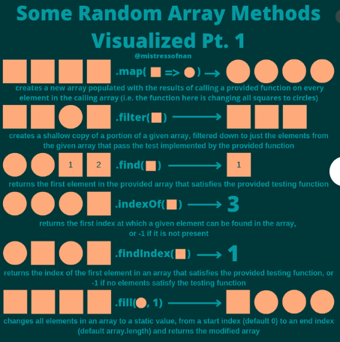
Other Loops

Slide 11
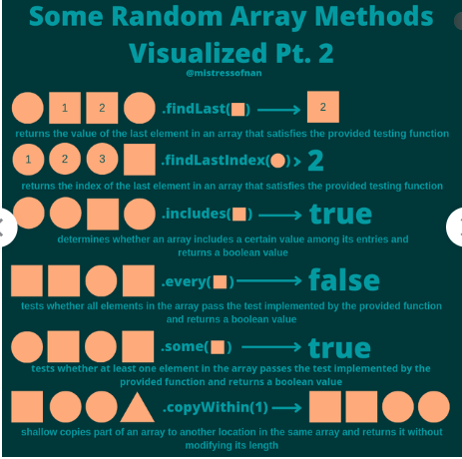
Other Loops

Slide 12
Other Loops

Slide 13
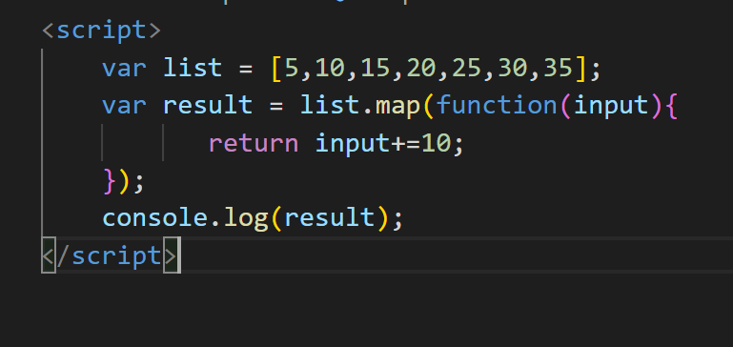

Map

Slide 14
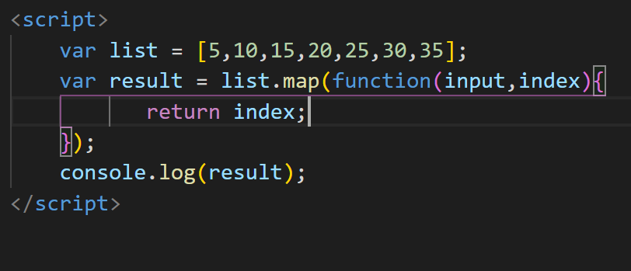

Map with index value

Slide 15
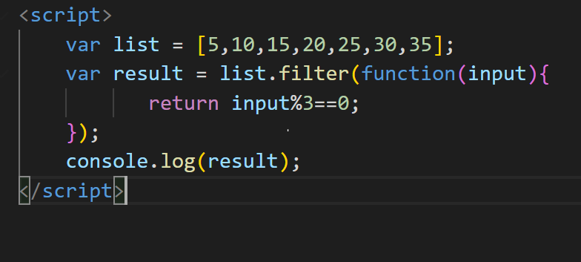

Filter

Slide 16
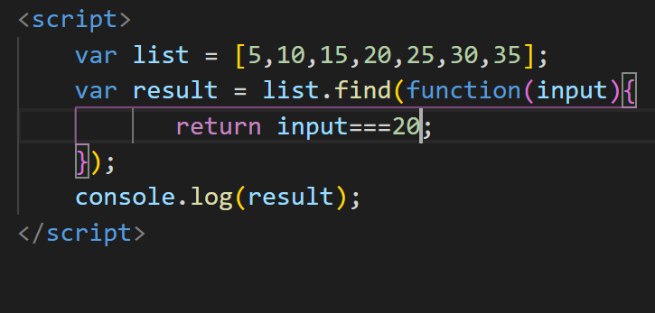

Find

Slide 17
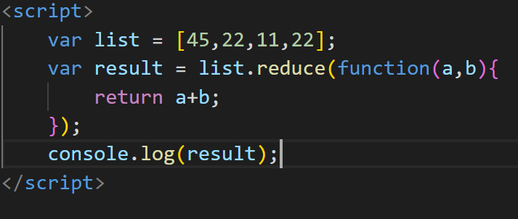
reduce

Slide 18
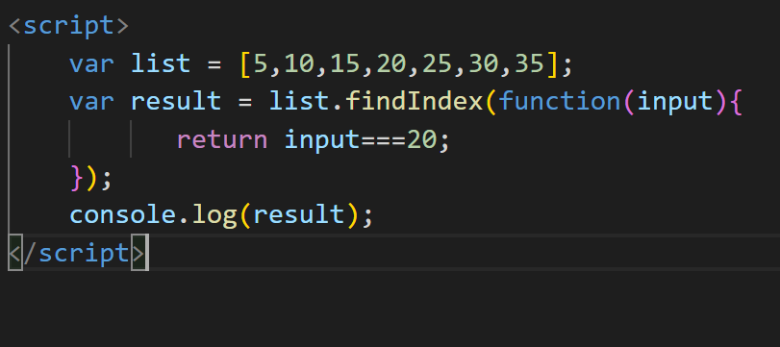
findIndex

Slide 19
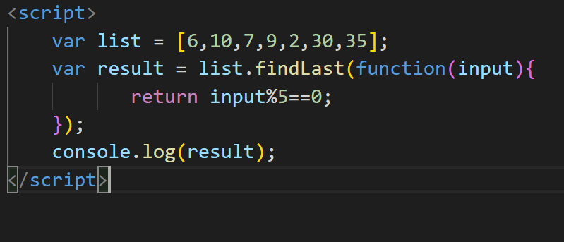
findLast

Slide 20
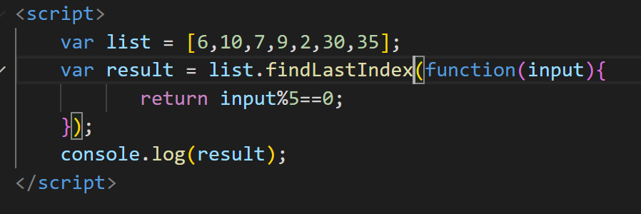
findLastIndex

Slide 21
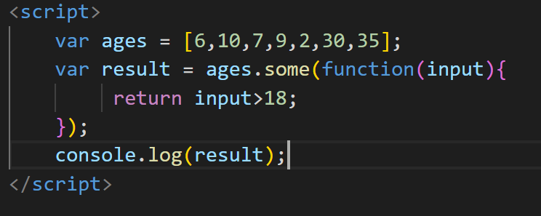

some

Slide 22
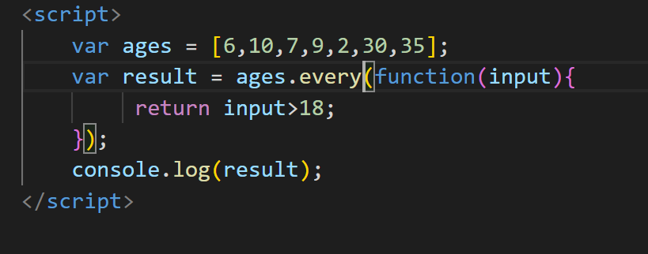

every

Slide 23
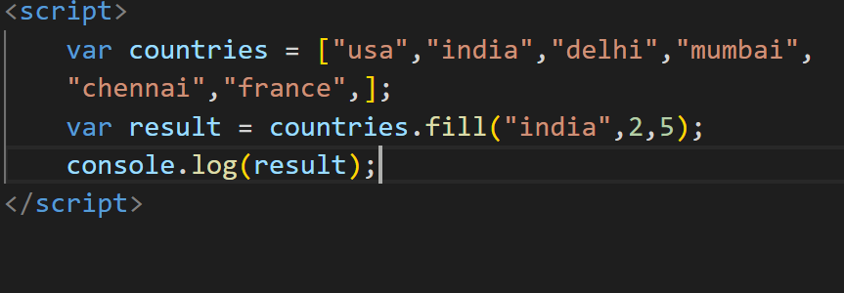
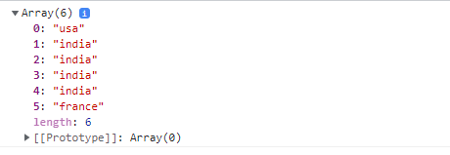
Fill

Slide 24
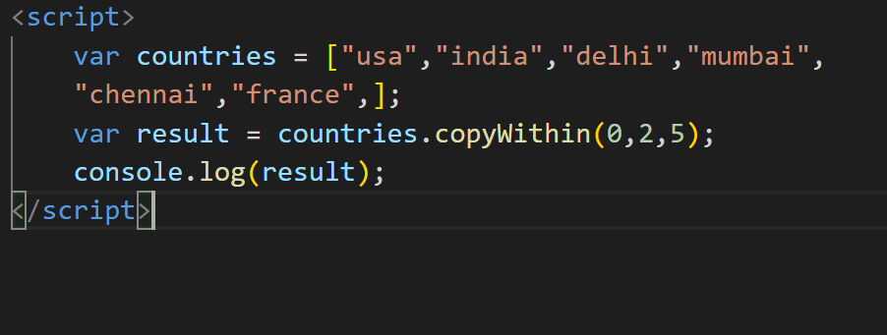
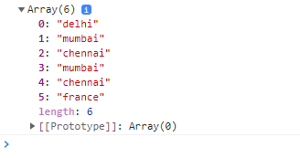
copywithin

Slide 25
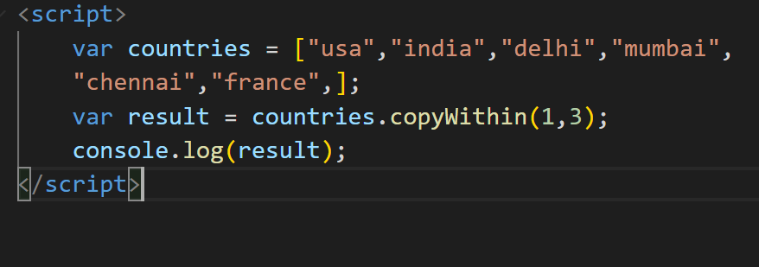

Copywithin

Slide 26
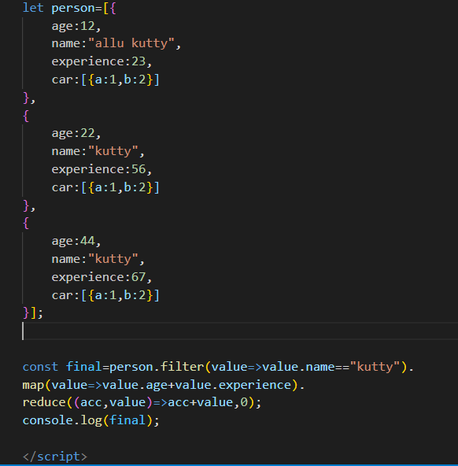
Map,Filter,Reduce

Slide 27
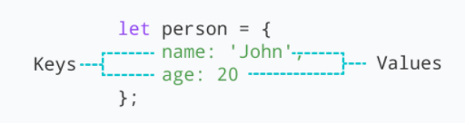
Object
JavaScript object is a non-primitive data-type that allows you to store multiple collections of data
Syntax:
const object_name = {
key1: value1,
key2: value2
}
// object creation
let person = {
name: 'John',
age: 20
};
console.log(typeof person); // object
"key: value" pairs are called properties

Slide 28
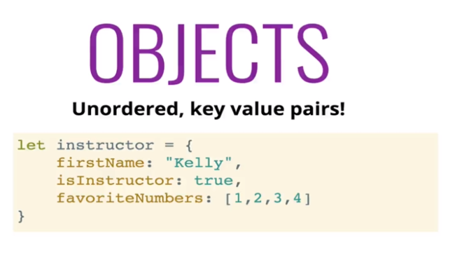
What is object

Slide 29
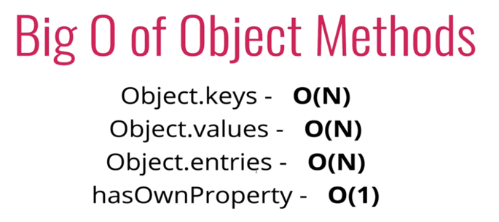
Time and space complexity

Slide 30
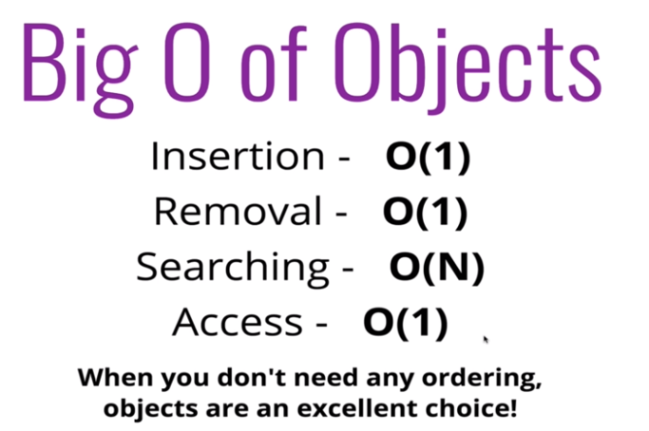
When to use it?

Slide 31
Object
Accessing Object Properties:
Syntax:
objectName.key
Or
objectName["propertyName"]
const person = {
name: 'John',
age: 20,
};
// accessing property
console.log(person.name); // John
const person = {
name: 'John',
age: 20,
};
// accessing property
console.log(person["name"]); // John

Slide 32
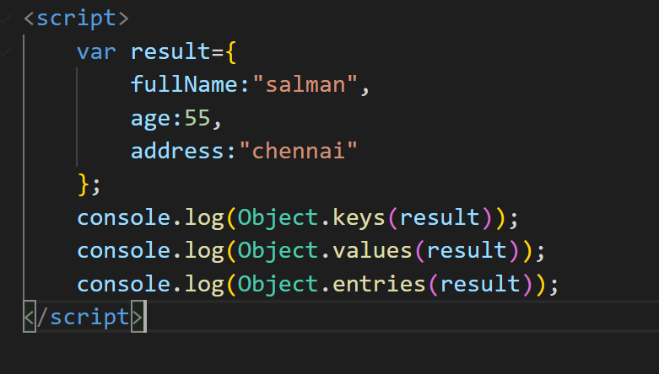
Object – for…in
Loop through an object Using for...in
const student = {
name: 'John',
age: 20,
hobbies: ['reading', 'games', 'coding'],
};
// using for...in
for (let key in student) {
let value;
// get the value
value = student[key];
console.log(key + " - " + value);
}

